Slide 1
SQL PROJECT
MUSIC STORE DATA ANALYSIS

Slide 2
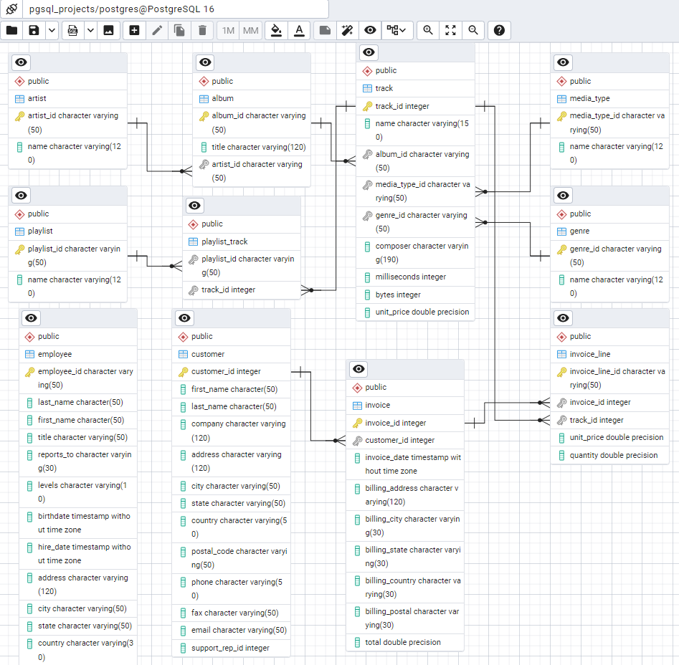
Data model

Slide 3
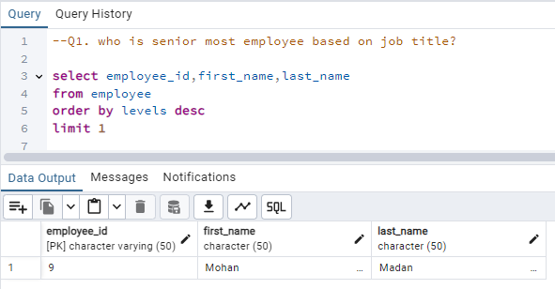
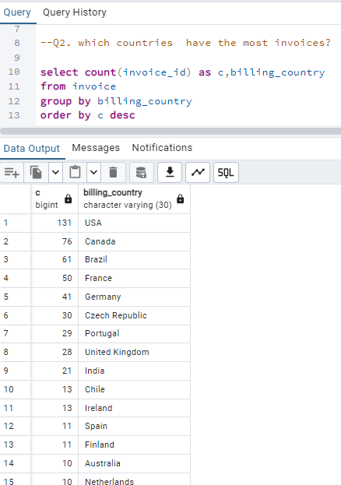
1. who is senior most employee based on job title ? 2. which countries have the most invoices ?

Slide 4
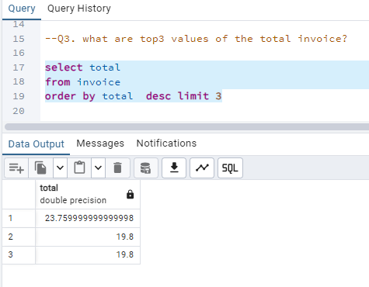
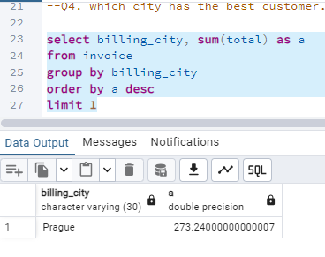
1. what are top3 values of the total invoice ? 2. which city has the best customer. write a query that return one city that has the highest sum of invoice totals. return both the city name and sum of all invoice totals ?

Slide 5
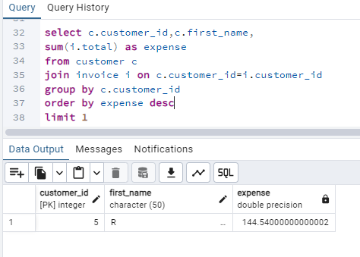
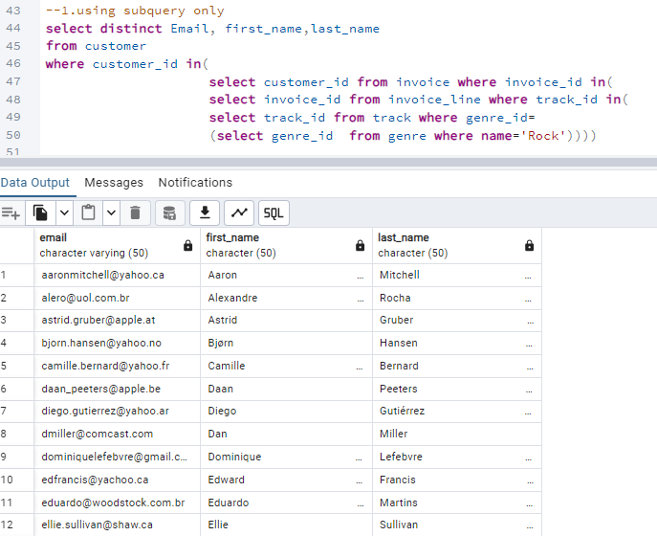
1. who is the best customer ? the customer who has spent the most money will be declared the best customer. who has spent most money ? 2. Write query to return the email, first name, last name, & Genre of all Rock Music listeners. Return your list ordered alphabetically by email starting with ‘A’ ?

Slide 6
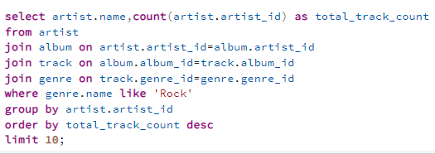
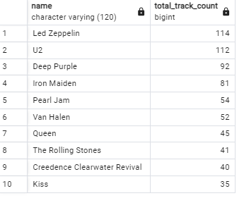
1. Let's invite the artists who have written the most rock music in our dataset. Write a query that returns the Artist name and total track count of the top 10 rock bands ?

Slide 7
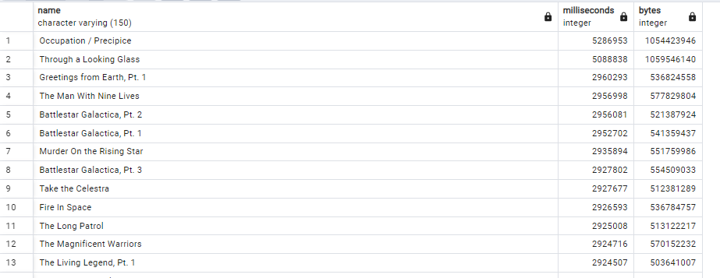
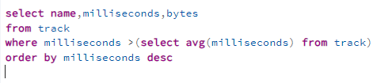
1. Return all the track names that have a song length longer than the average song length. Return the Name and Milliseconds for each track. Order by the song length with the longest songs listed first

Slide 8
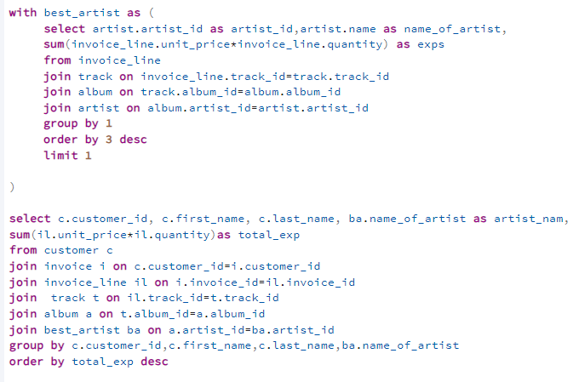
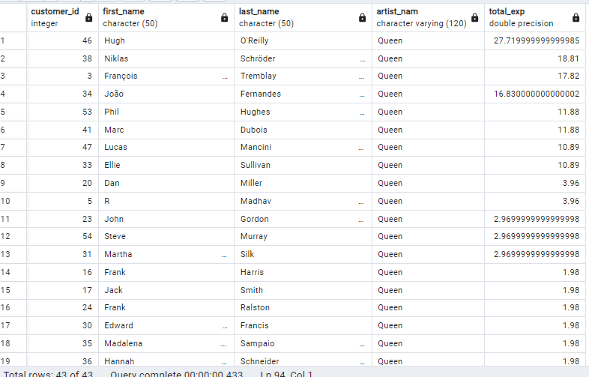
1. Find how much amount spent by each customer on artists? Write a query to return customer name, artist name and total spent

Slide 9
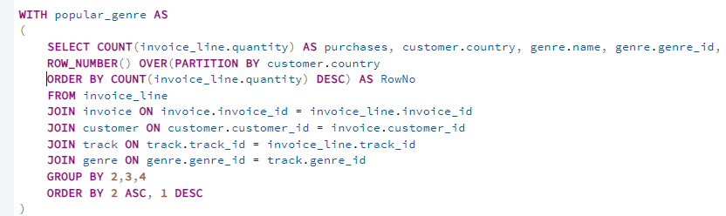
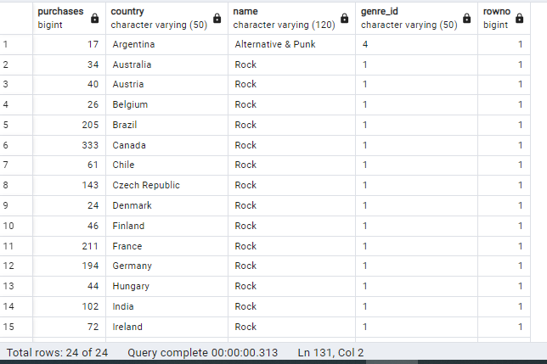
1. We want to find out the most popular music Genre for each country. We determine the most popular genre as the genre with the highest amount of purchases. Write a query that returns each country along with the top Genre. For countries where the maximum number of purchases is shared return all Genres.

